Slide 1
Lecture 4
Gradient descent

Slide 2
Introduction
In previous lectures we discussed how machine learning uses linear regression
In many cases however the cost function to be minimized is different than the one used in linear regression
Other algorithms, than solving the normal equations, are needed to minimize such general cost functions
In this lecture we discuss qualitatively the family of gradient descent methods which are popular in machine learning
Notes:
In previous lectures we discussed how machine learning uses linear regression
In linear regression the cost function had a particular shape, a quadratic function, which represents in fact the norm of the backward error of the set of none consistent equations resulting from applying the model to the data set. Finding the minimal backward error can be achieved by solving the normal equations.
In many cases however the cost function to be minimized is of different nature
Other algorithms, than solving the normal equations, are needed to minimize such general cost functions
In this lecture we discuss qualitatively the family of gradient descent methods which are popular in machine learning to minimize general cost functions
We don’t expect you after this lecture to be able to run such algorithms, but we would like that you have general idea about them as they are very popular algorithms and many machine learning libraries will implement them

Slide 3
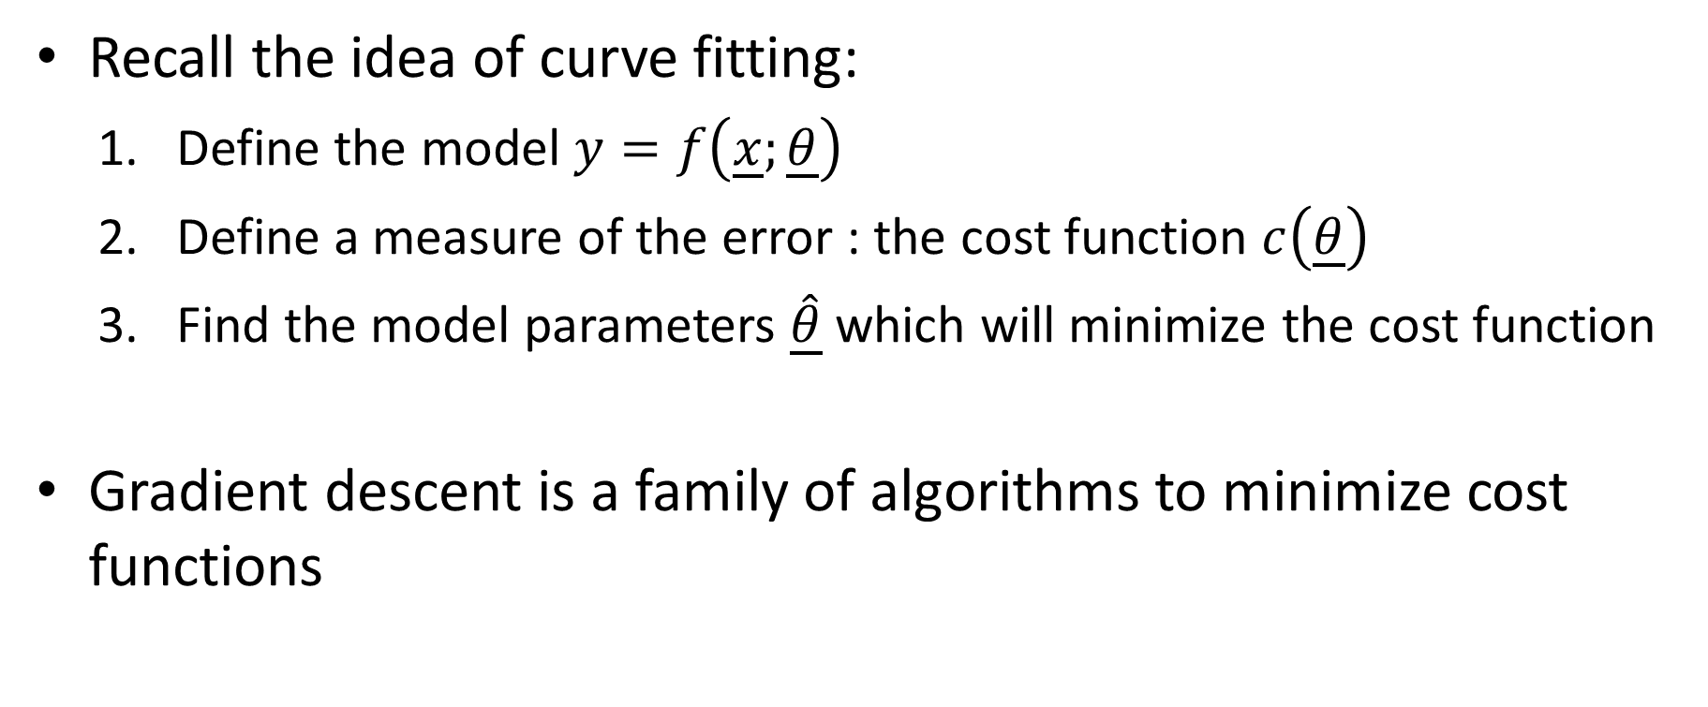
Gradient descent
Recall the idea of curve fitting:
Define the model $y=f\left(\underline{x};\underline{θ}\right)$
Define a measure of the error : the cost function $c\left(\underline{θ}\right)$
Find the model parameters $\underline{\hat{θ}}$ which will minimize the cost function
Gradient descent is a family of algorithms to minimize cost functions
Notes:
Let us recall the basic idea of curve fitting
First we chose a model we would like to use to describe our data set
Second we choose a measure of the error which is relevant for our problem. This measure is called the cost function
Third we Find the model parameters $\underline{\hat{θ}}$ which will minimize this cost function
Finding the minimum of a cost function can become a very challenging problem.
In this lecture we will discuss qualitatively the family of gradient descent algorithms used to minimize cost functions

Slide 4
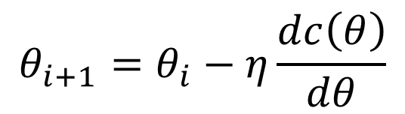





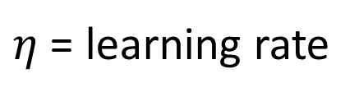
Basic idea
Case for a cost function in one variable $θ$
$$θ_{i+1}=θ_{i}−η\frac{dc\left(θ\right)}{dθ}$$
$$c(θ)$$
$η$ = learning rate
One step of this algorithm is usually referred as learning step
$$θ_{0}$$
$$\hat{θ}$$
$$θ$$
Notes:
The basic idea of the gradient descent algorithm is very simple
Consider a cost function c depending on a single variable $θ$
The goal is to find the minimum of this function
For this we start with an initial guess $θ_{0}$
Pay attention to not mix up $θ_{0}$ with the bias term of linear models
The algorithm then produces an improved guess $θ_{1}$. It does this by following the descended slope of the cost function. The same way you would do if you are hiking in the mountains and want to reach to bottom of a valley
The algorithm proceeds further the same way until approaching the minimum $\hat{θ}$ of the cost function
Written in equations the iteration scheme is very simple:
$$θ_{i+1}=θ_{i}−η\frac{dc\left(θ\right)}{dθ}$$
The parameter $η$ is called the learning rate and can be freely chosen
We will discuss shortly how the choice of this parameter affects the algorithm
Note the negative sign which is needed to make sure $θ_{i+1}$ is indeed a point following the descendent slope of the cost function
In machine learning, a step of this algorithm is called a learning step

Slide 5









Learning rate
The learning rate $η$ is called a hyper-parameter
learning rate is too small
learning rate is too large
$$c(θ)$$
$$c(θ)$$
$$θ_{0}$$
$$\hat{θ}$$
$$θ$$
$$θ_{0}$$
$$\hat{θ}$$
$$θ$$
Notes:
Let us discuss qualitatively how the choice of the parameter $η$ affects the algorithm
A quick note on machine learning terminology
In machine learning parameters you have to chose, an usually fine tune, in operating an algorithm are called hyper-parameters
So how the choice of the hyper-parameter $η$ affects the gradient descent algorithm?
Let us first consider a case where $η$ is chosen too small
In this case, the algorithm will progress very slowly as each learning step will only improve very slightly $θ_{i}$
On the other hand, if we choose $η$ is chosen too large, the algorithm may start to jump around the minimum and will become difficult to locate it
We don’t discuss in this term how you choose optimal learning rates. Just be aware that too small or too large learning rates are not desired

Slide 6




Pitfalls
$$c(θ)$$
plateau
local minima
global minima
$$θ_{0}$$
$$\hat{θ}$$
$$θ$$
Notes:
There are as well several pitfalls in the gradient descent algorithm
First of call, the algorithm will typically get stuck inside a local minima and not be able to find the global minima if the initial choice isn’t a good one
Plateaus in the cost function can become problematic too as in these situations the algorithm will progress very slowly or in extreme case even misinterpret the plateau as a minima

Slide 7

Multi-Dimensions
For cost functions with more than one variable (Batch gradient descent):
$${\underline{θ}}_{i+1}={\underline{θ}}_{i}−η∇_{\underline{θ}}c\left(\underline{θ}\right)$$
$${\underline{θ}}_{i+1}={\underline{θ}}_{i}−η\left[\begin{matrix}\frac{∂}{∂θ_{0}}c\left(\underline{θ}\right) \\ ⋮ \\ \frac{∂}{∂θ_{n}}c\left(\underline{θ}\right)\end{matrix}\right]$$
Notes:
If in the case of a cost function with a single variable, the gradient descent algorithm can be visualized on a simple plot, in the case of many dimensions this is not possible
But the algorithm itself writes the same way using vector notation. The first derivative of the cost function is replaced by the gradient of the cost function, which gives the name to the algorithm

Slide 8





Additional issues in multi-dimensions
$$θ_{2}$$
$$θ_{2}$$
scaled
unscaled
$$c\left(θ_{1},θ_{2}\right)=\text{constant}$$
$$θ_{1}$$
$$θ_{1}$$
Notes:
In higher dimensions serval additional issues need to be addressed
One of them we want to mention here is the issue of scaling
Depending on what represents the features $θ_{i}$ of our model, the range of values may be very different from one feature to another
If you recall the example of the electroploshing, one feature may be the specific gravity of the bath, a number not far from 1, whereas another one may be the electrical conductivity of the bath measured in mS/cm, a number typically around 100-200
This would result in cost function as represented on the figure. The plot shows the locations where the cost function has a given constant value, so-called contour or level plots
As the numerical values of the two features have very different ranges, this results in elongated counter plots.
A gradient descent algorithm would progress quickly along one of the dimensions but then become very slow along the other one
A simple trick to overcome this issue is scaling.
Scaling is a common tool used in machine learning where one applies some scaling factors to the features in order to bring them all into a similar range.
In our example from the electroploshing bath we could simply divide the electrical conductivity by a constant factor 100. In this case specific gratify and the scaled electrical conductivity both would be numbers around 1-2
The resulting cost function becomes then much more symmetric as shown on the plot
The gradient descent will then work with similar speed in all directions

Slide 9
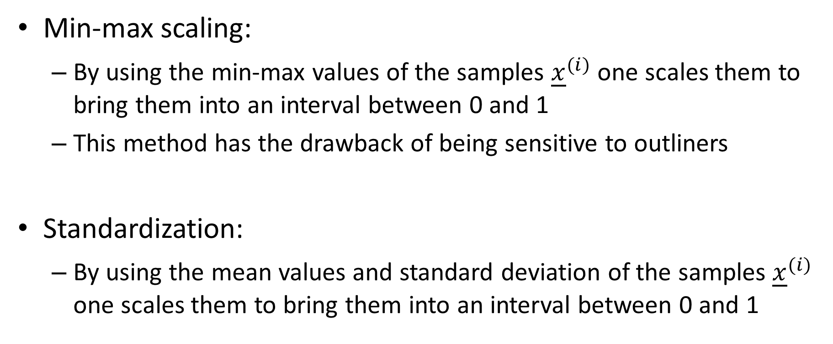
Scaling
Min-max scaling:
By using the min-max values of the samples ${\underline{x}}^{(i)}$ one scales them to bring them into an interval between 0 and 1
This method has the drawback of being sensitive to outliners
Standardization:
By using the mean values and standard deviation of the samples ${\underline{x}}^{(i)}$ one scales them to bring them into an interval between 0 and 1
Notes:
There exist several ways to scale data sets
Tow popular ways used in machine learning are the min-max scaling and the standardization
In min-max scaling the minimal and maximal values of the samples ${\underline{x}}^{(i)}$ are used to bring them to an interval between 0 and 1
This method has however the drawback of being sensitive to outliners
In standardization the mean values and standard deviation of the samples ${\underline{x}}^{(i)}$ are used to bring them into an interval between 0 and 1

Slide 10
Stochastic gradient descent
For a large data set, gradient descent is very time consuming as the gradient of the cost function needs to be computed over the complete data set in each learning step
An alternate way is stochastic gradient descent
The algorithm does not evaluate the gradient of the cost function over the full data set, but over randomly selected sub-sets
Notes:
For a large data set, gradient descent is very time consuming.
In fact for large data set this way of operating the algorithm is not practical at all and would result in very large computational times
This is because in each learning step, the gradient of the cost function needs to be computed over the complete data set
That is why this way of operating the gradient descent algorithm is called batch gradient descent.
An alternate way is the stochastic gradient descent algorithm
This algorithm does not evaluate the gradient of the cost function over the full data set, but over randomly selected sub-sets

Slide 11


Stochastic gradient descent
$$θ_{2}$$
Faster than batch gradient descent
can potentially avoid local minima
Can not find the minima. It will only get close to it
$$θ_{1}$$
Notes:
Stochastic gradient descent is among one among the popular algorithms used in machine learning to minimize cost functions
It presents several advantages such as
To be faster than batch gradient descent
And it can potentially avoid local minima as it tends to jump randomly downwards the minimum and consequently can jump out of a local minima valley
The major drawback is however that it can not really find the minima but only get close to it

Slide 12
Learning schedules
To address the problem that the stochastic gradient descent can only get close to a minimum, one uses the trick of learning schedules
Learning schedule is a rule to adjust the learning rate as the algorithm will progress
The learning schedule is designed to reduce the learning rate as the iterations increase
This is often referred to as simulated annealing
Notes:
To address the problem that the stochastic gradient descent can only get close to a minimum, one uses the trick of learning schedules
The idea is to adjust the learning rates as the algorithm will progress. The closer we come to the minima, the smaller the learning rate needs to be made.
The rule to adjust the learning rate is called the learning schedule
The learning schedule is designed to reduce the learning rate as the iterations increase
In machine learning, a learning schedule which decreases the learning rate over the number of iterations, is said to produce simulated annealing
This terminology is inspired by material science where annealing is used to harden steel for example

Slide 13
Summary
The technic of the normal equations can only be applied to particular cost functions
For general cost functions alternate algorithms are needed
A popular family of such algorithms are the gradient descent algorithms
The find the minima of a cost function the gradient descent follows the descended slope of the cost function towards the minima
Scaling is usually needed to operate this family of algorithms
A fast version is the stochastic gradient descent where random sub-sets of the data set are used to operate the algorithm
Notes:
Let us summarize the key findings
The technic of the normal equations can only be applied to particular cost functions
For general cost functions alternate algorithms are needed
A popular family of such algorithms are the gradient descent algorithms
The find the minima of a cost function the gradient descent follows the descended slope of the cost function towards the minima
Scaling is usually needed to operate this family of algorithms
A fast version is the stochastic gradient descent where random sub-sets of the data set are used to operate the algorithm

